Slide 1
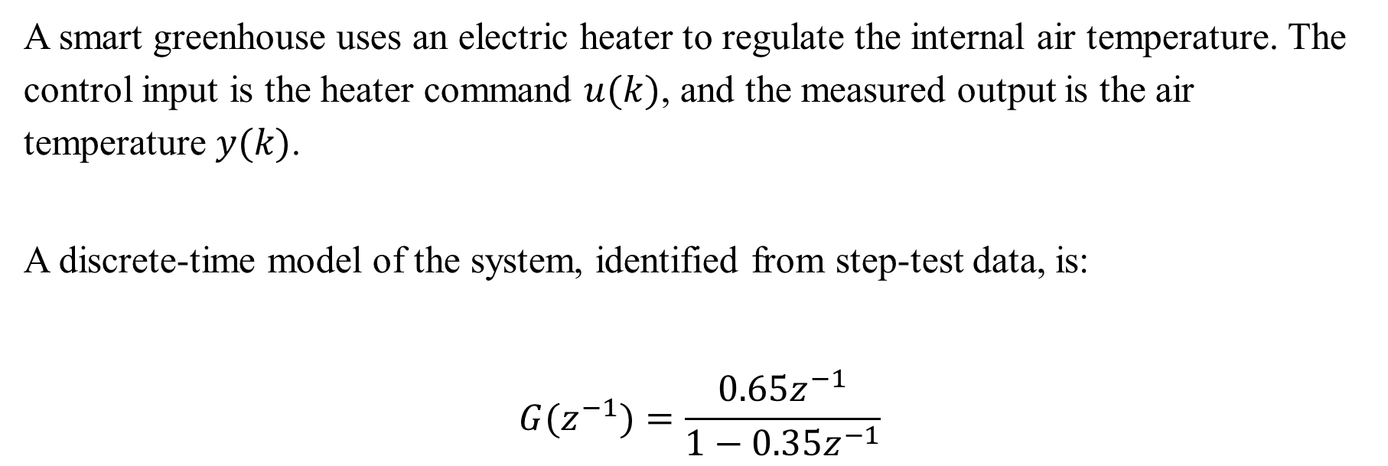
Question
A smart greenhouse uses an electric heater to regulate the internal air temperature. The control input is the heater command $u(k)$, and the measured output is the air temperature $y(k)$.
A discrete-time model of the system, identified from step-test data, is:
$$G(z^{−1})=\frac{0.65z^{−1}}{1−0.35z^{−1}}$$

Slide 2
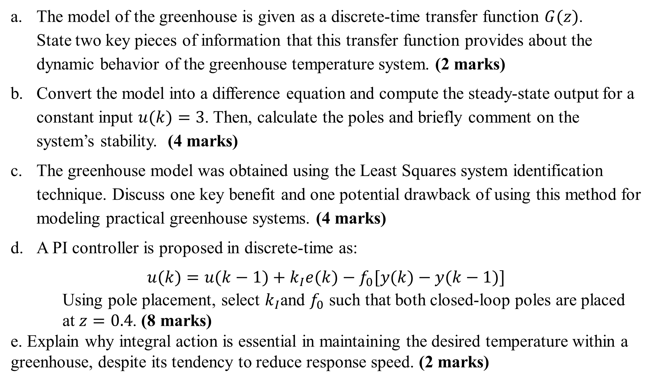
The model of the greenhouse is given as a discrete-time transfer function $G(z)$. State two key pieces of information that this transfer function provides about the dynamic behavior of the greenhouse temperature system. (2 marks)
Convert the model into a difference equation and compute the steady-state output for a constant input $u(k)=3$. Then, calculate the poles and briefly comment on the system’s stability. (4 marks)
The greenhouse model was obtained using the Least Squares system identification technique. Discuss one key benefit and one potential drawback of using this method for modeling practical greenhouse systems. (4 marks)
A PI controller is proposed in discrete-time as:
$$u(k)=u(k−1)+k_{I}e(k)−f_{0}[y(k)−y(k−1)]$$
Using pole placement, select $k_{I}$and $f_{0}$ such that both closed-loop poles are placed at $z=0.4$. (8 marks)
e. Explain why integral action is essential in maintaining the desired temperature within a greenhouse, despite its tendency to reduce response speed. (2 marks)

Slide 3
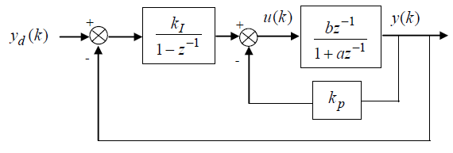
Consider the application of a PI controller with unity time delay as shown below.
a. Find the closed-loop transfer function relating to y(k) and y_{d}(k). | 4
b. Find the steady state gain of the closed-loop system and comment on its significance. 4

Slide 4
c. Given the parameters of the model, i.e., a= -0.6 and b=3, Calculate the proportional and integral gains that yield closed-loop poles at 0.3 and 0.4 on the complex z-plane. | 4
d. Using examples from real-world applications, explain why closed-loop systems are often preferred for systems that require precise and stable outputs. | 4
e. Explain the key differences between minimal and non-minimal state-space representations in control systems. Provide a specific real-world example where a non-minimal state-space model is preferred and justify the choice of this representation in that scenario.. | 4

